Slide 1
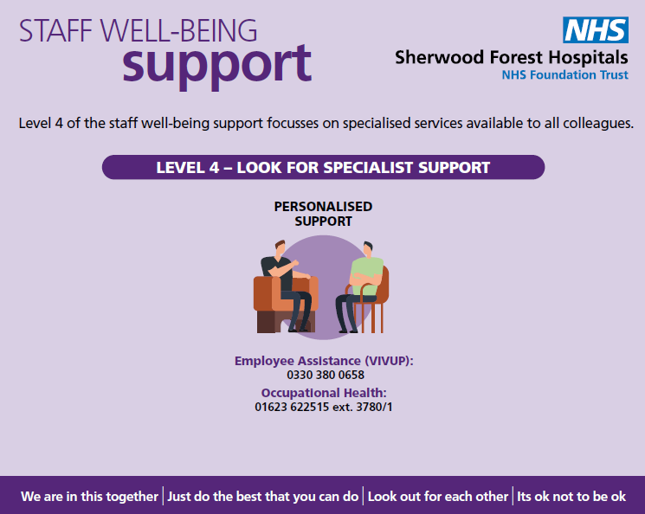
Coaching Support for Black, Asian and Minority Ethic Colleagues
#LookingAfterYouToo: an individual coaching support offer for Black, Asian, and Minority Ethnic staff working in NHS and ambulance trusts:
This programme has been developed to offer any NHS colleagues who identify as part of our Black, Asian, and Minority Ethnic workforce in NHS and ambulance trusts, is supported to maintain their psychological wellbeing during this challenging time. This individually tailored coaching support will focus on proactively supporting you to process experiences, offload the demands of whatever you are experiencing, deal with difficult conversations, develop coping skills and be supported in developing practical strategies.
Additional places have been added to the programme and new dates available. Please visit to book if you are interested,
https://people.nhs.uk/lookingafteryoutoo/registerbook-bame/

