Slide 1
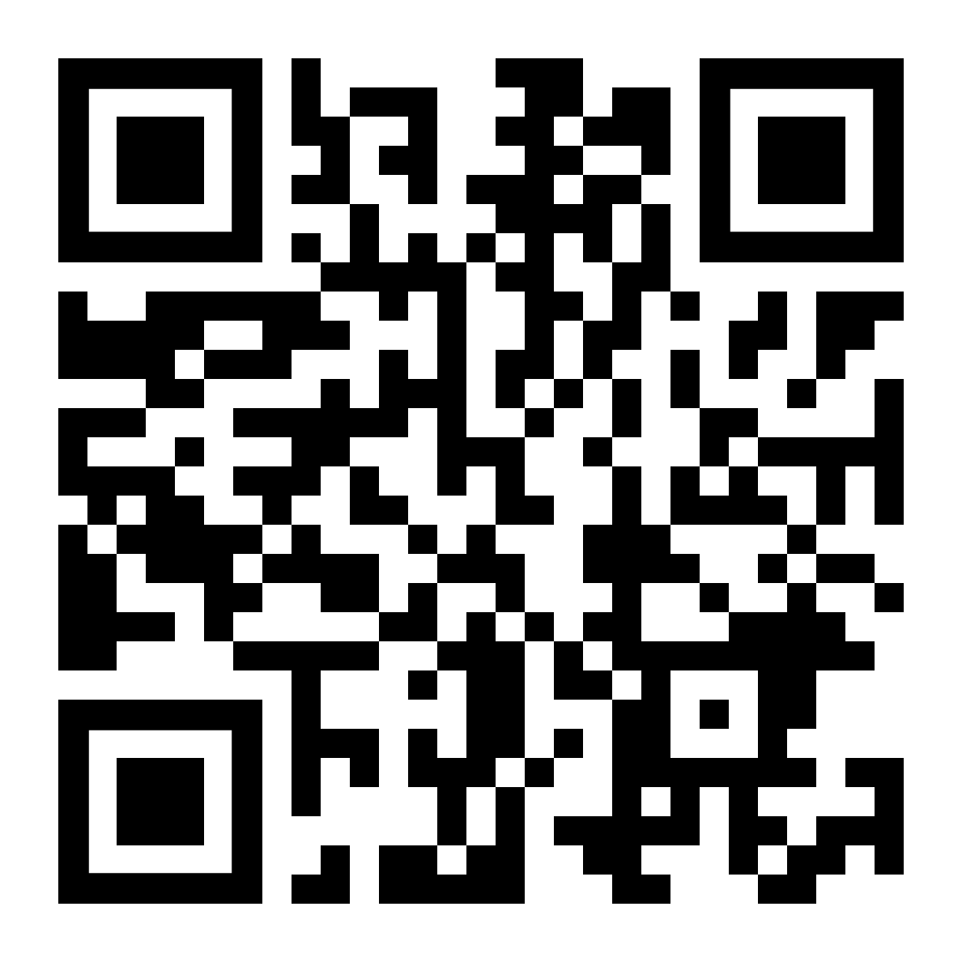
Citizens Advice
Offer free and confidential advice to all on a range of different topics; such as
Housing
Debt management
Benefits - including universal credit, working tax credits,
Family
Law and courts and rights
Health and care
For further advice please telephone 01623 203080 Please identify yourselves as employees of Sherwood Forest Hospitals to the receptionist.
Please visit https://www.citizensadvice.org.uk/ to view more information or using the QR code.

