Slide 1
East Midlands Endoscopy Training Centre
Staff Story 2020

Slide 2
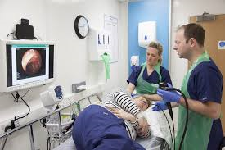
What Is An Endoscopy?
NHS UK
An endoscopy is a procedure where organs inside your body are looked at using an instrument called an endoscope. An endoscope is a long, thin, flexible tube that has a light and camera at one end. Images of the inside of your body are shown on a television screen.

Slide 3
What Procedures Do We Offer At SFH?
Gastroscopy
Colonoscopy
Flexible Sigmoidoscopy
ERCP
Bronchoscopy
Cystoscopy
Capsule Endoscopy
Upper GI Manometry
Percutaneous Endoscopic Gastrostomy (PEG)

Slide 4
Background To Training
Apprenticeship Style Training with No Formal Regulation
1994 Joint Advisory Group (JAG) Formed to Standardise Training
1999 Unacceptable Standards of Practice Reported during Audit in Preparation for Bowel Cancer Screening Programme
Led To Review Of Endoscopy Training
2004 NCEPOD ‘Scoping Our Practice’ Highlighted Shortfalls in Quality of Care
As A Result Global Rating Score (GRS) Introduced as Quality Improvement Tool
2004 (JAG) Produced Training Standards
2005 JAG Produced Guidelines for Non-Medical Endoscopists
2005 JAG Accredited Courses for upper & lower GI endoscopy compulsory
2009 JAG Endoscopy Training System (JETS) launched

Slide 5
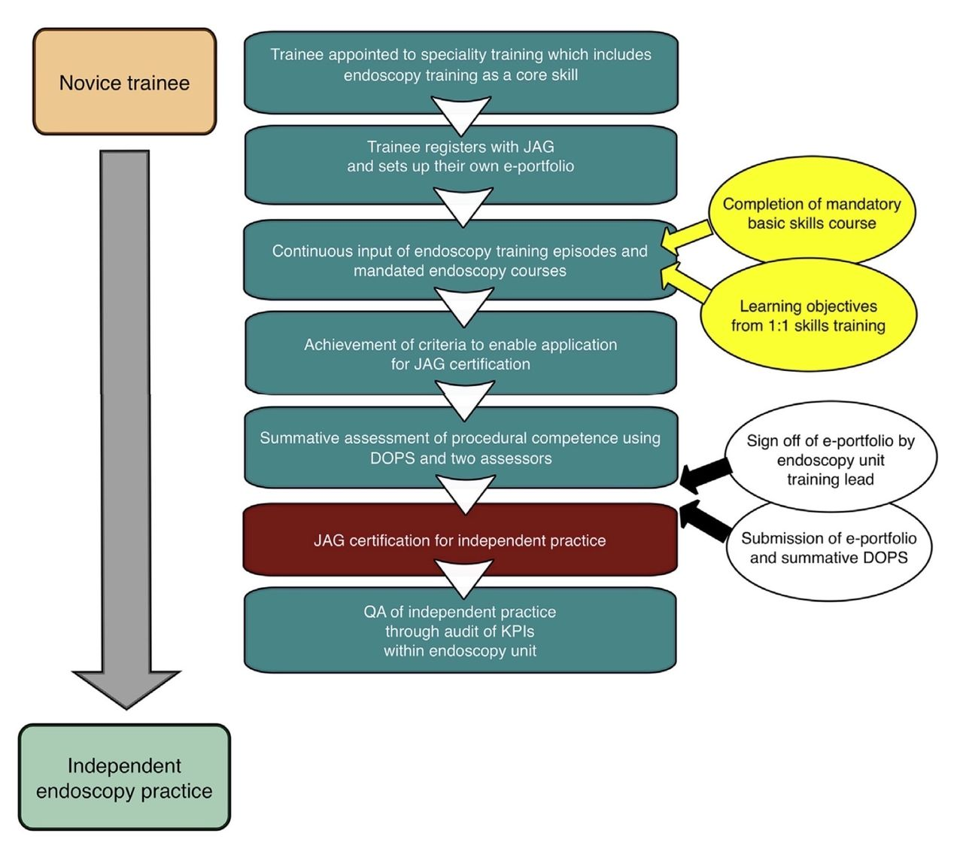
JAG Trainee Certification Pathway

Slide 6
Courses We Offer
Basic Skills in Upper GI
Basic Skills in Colonoscopy
Polypectomy and Advanced Colonoscopy
NME upper & lower
Train the Gastroscopy Trainer
Train the Colonoscopy Trainer

Slide 7
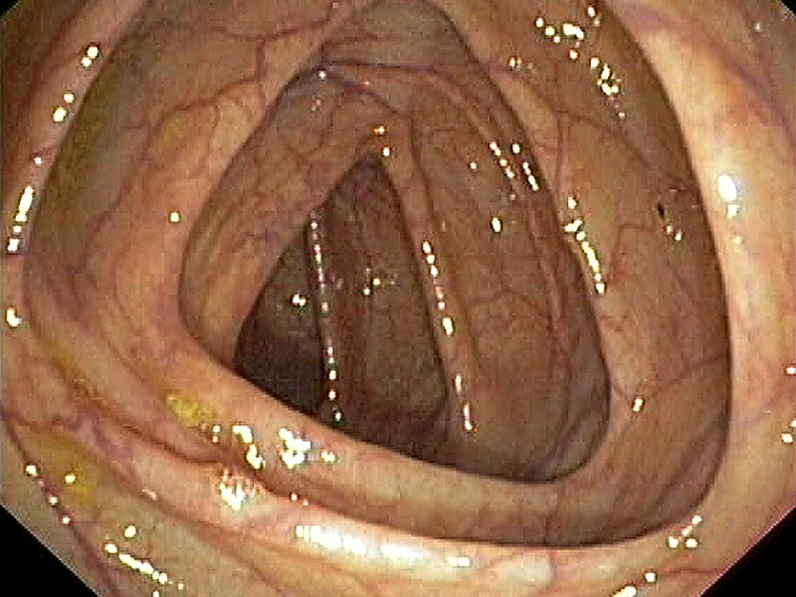
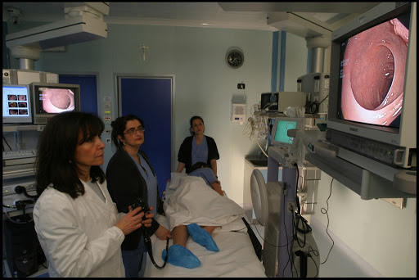
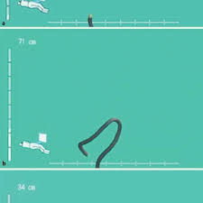
Format Of The Courses

Slide 8
SFH Way
Focus on Individual Needs of Candidates
Friendly & Approachable
Consent of Patients at Time of Booking Procedure
Highly Skilled Faculty Supporting 1:1 During Procedure
Timely Intervention to Maintain Learning Experience & Patient Satisfaction
Involvement of All Nursing Staff to Support Their Progression
Maximum Exposure to Practical Skills - ‘Hands On’ Approach
Interaction With Different Specialities
Share Knowledge & Skills
Passionate About Training
Focus Heavily on ENTS

Slide 9
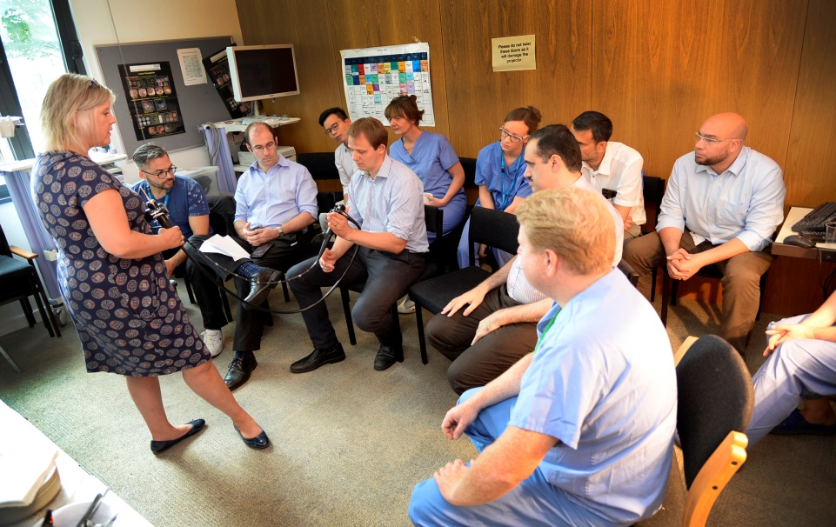
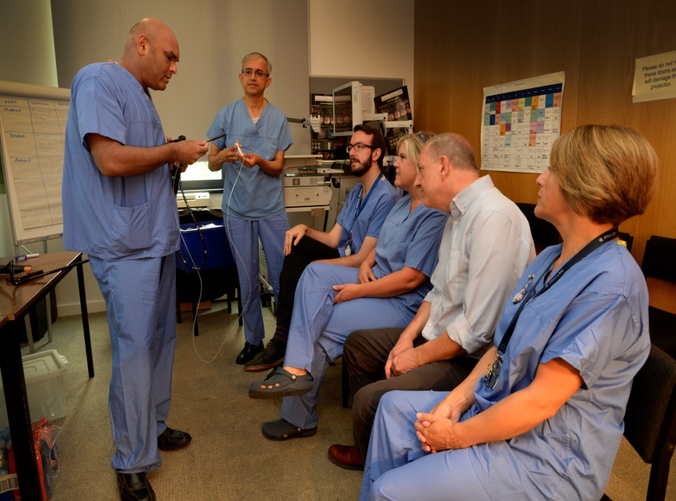
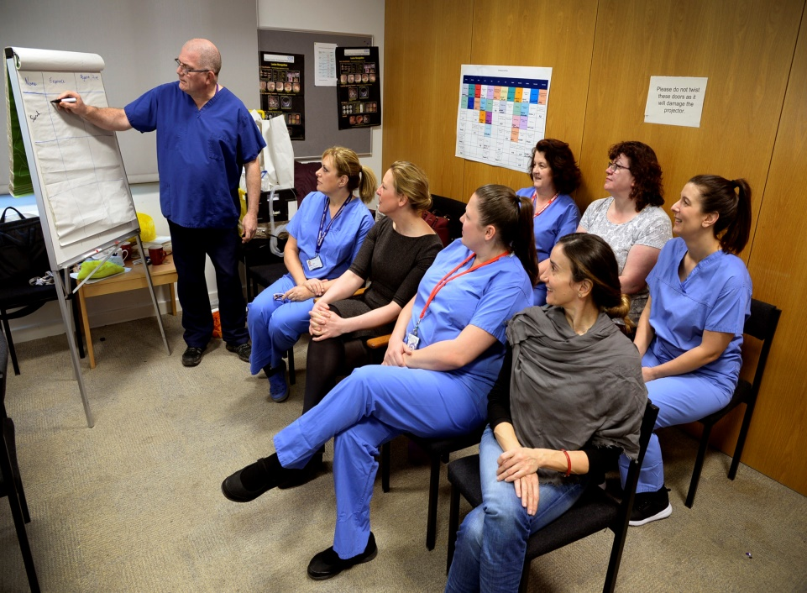
Photos & Faculty

Slide 10
Dr Steve Foley Endoscopy Lead & Consultant Gastroenterologist
Sharon Hudson Clinical Endoscopist
Mark Jones Clinical Endoscopist
Mr K Badrinath Consultant Surgeon Colorectal
Mr R Hind Consultant Surgeon Colorectal
Mr N Watson Consultant Surgeon Colorectal
Miss E Gemmill Consultant Surgeon Upper GI
Miss J Patterson Consultant Surgeon Upper GI
Alison Bird Clinical Endoscopist
Charikleia Kalogeri Clinical Endoscopist
Fay Oxley Course Co-ordinator
Jane Cartwright Deputy Department Leader
Dr S Niaz International Faculty Karachi

Slide 11
Feedback
Really allowed me time to do the procedure whilst giving me tips to improve throughout, very useful! thanks so much
Fantastic training faculty, brilliant endoscopy unit. All very welcoming. This is the second time I have been here and it was amazing just like the first time. Thank you all for your support
Great - educational and fun - many thanks
Enjoyable and educational - very grateful.
Enjoyable and educational - what more could you hope for.
Amazing course. All the faculty were helpful, patient and fantastic trainers.
Very useful course with a friendly bunch of teachers.
The location, hospitality and friendliness of the staff was exemplary

Slide 12
“It goes without saying that no man can teach successfully who is not at the same time a student”
William Osler 1905

